Slide 1


Ndi Nchanji Blaise
21 July 2024

Slide 2

Outline
Executive Summary
Introduction
Methodology
Results
Conclusion
Appendix

Slide 3
Executive Summary
The goal of this research is to analyze SpaceX Falcon 9 data collected through various sources and employ Machine Learning models to predict the success of first stage landing that provides other space agencies the ability to decide if they bid against SpaceX.
Summary of methodologies
The following concepts and methods were used to collect and analyze data, build and evaluate machine learning models, and make predictions: • Collect data through API and Web scraping • Transform data through data wrangling • Conduct exploratory data analysis with SQL and data visuals • Build an interactive map with folium to analyze launch site proximity • Build a dashboard to analyze launch records interactively with Plotly Dash • Finally, build a predictive model to predict if the first stage of Falcon 9 will land successfully
Summary of all results
• This report will share results in various formats such as:
• Data analysis results • Data visuals interactive dashboards • Predictive model analysis results

Slide 4
Introduction
Project background and context
• With the recent successes in private space travel, space industry is becoming more and more mainstream and accessible to general population. Cost of launch continues to remain a key barrier for new competitors to enter the space race • SpaceX with its first stage reuse capabilities offers a key advantage against its competitors. Each SpaceX launch costs around 62 million dollar and SpaceX can reuse stage 1 for future launches. This provides SpaceX a unique advantage where other competitors are spending around 165 mission plus for each launch.
Problems you want to find answers
• Determine if the first stage of SpaceX Falcon 9 will land successfully • Impact of different parameters/variables on the landing outcomes (e.g., launch site, payload mass, booster version, etc.) • Correlations between launch sites and success rate.

Slide 5

Section 1

Slide 6
Methodology
Executive Summary
Data collection methodology:
• SpaceX API • Web scrap Falcon 9 and Falcon Heavy launch records from Wikipedia (link)
Perform data wrangling
• Determined labels for training the supervised models by converting mission outcomes in to training labels (0-unsuccessful, 1-successful)
Perform exploratory data analysis (EDA) using visualization and SQL
Perform interactive visual analytics using Folium and Plotly Dash
Perform predictive analysis using classification models
• Created a column for ‘class’; standardized and transformed data; train/test split data; find best classification algorithm (Logistic regression, SVM, decision tree, & KNN) using test data

Slide 7
Data Collection
For this project, data was collected via SpaceX API and Web scrapping Wiki pages for relevant launch data.
API used: SpaceX API endpoint for past launches. Data collected: Launch details, rocket details, payload information, and core outcomes. Initial data structure: JSON format, converted to pandas DataFrame.
Extracted key features using helper functions: Rocket details (booster name).Launchpad details (site name, longitude, latitude).Payload details (mass, orbit).Core details (landing outcome, type, number of flights, gridfins, reuse status, landing pad, block, serial).
Notes:
Data collection is the process of gathering data from available sources. This data can be structured, unstructured, or semi-structured.

Slide 8
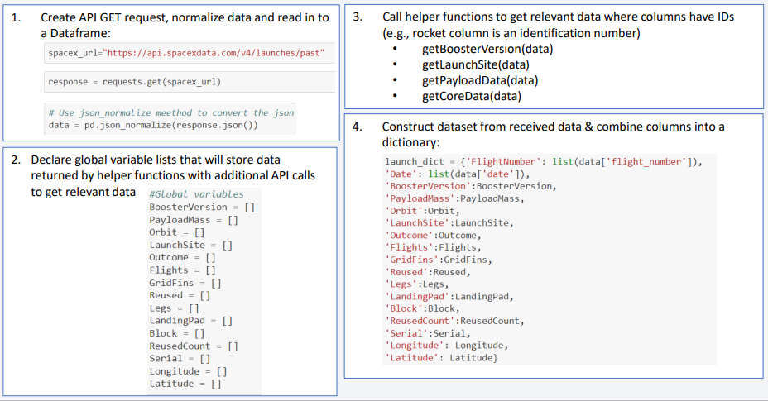
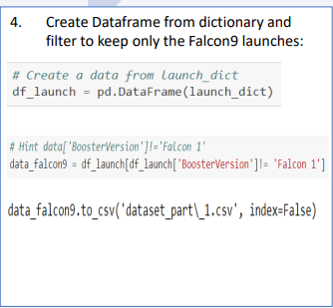

Data Collection – SpaceX API

Slide 9
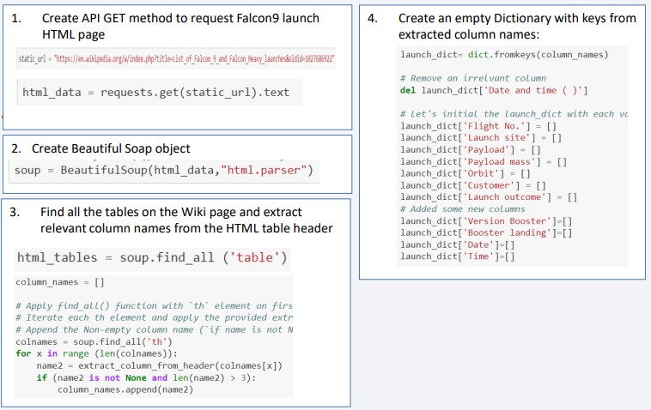
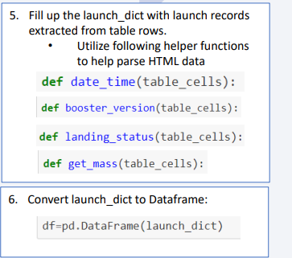
Data Collection - Scraping

Slide 10
Data Wrangling
Conducted Exploratory Data Analysis (EDA) to find patters in data and define labels for training supervised models
• The data set contained various mission outcomes that were converted into Training Labels with 1 meaning the booster successfully landed and 0 meaning booster was unsuccessful in landing. Following landing scenarios were considered to create labels:
• True Ocean means the mission outcome was successfully landed to a specific region of the ocean
• False Ocean means the mission outcome was unsuccessfully landed to a specific region of the ocean
• RTLS means the mission outcome was successfully landed to a ground pad
• False RTLS means the mission outcome was unsuccessfully landed to a ground pad
• True ASDS means the mission outcome was successfully landed on a drone ship
• False ASDS means the mission outcome was unsuccessfully landed on a drone ship

Slide 11
EDA with Data Visualization
• As part of the Exploratory Data Analysis (EDA), following charts were plotted to gain further insights into the dataset:
1. Scatter plot:
• Shows relationship or correlation between two variables making patterns easy to observe • Plotted following charts to visualize:
• Relationship between Flight Number and Launch Site
• Relationship between Payload and Launch Site
• Relationship between Flight Number and Orbit Type
• Relationship between Payload and Orbit Type
2. Bar Chart:
• Commonly used to compare the values of a variable at a given point in time. Bar charts makes it easy to see which groups are highest/common and how other groups compare against each other. Length of each bar is proportional to the value of the items that it represents • Plotted following Bar chart to visualize: • Relationship between success rate of each orbit type
3. Line Chart:
• Commonly used to track changes over a period of time. It helps depict trends over time. • Plotted following Line chart to observe: • Average launch success yearly trend

Slide 12
EDA with SQL
To better understand SpaceX data set, following SQL queries/operations were performed on an IBM DB2 cloud instance:
1. Display the names of the unique launch sites in the space mission 2. Display 5 records where launch sites begin with the string 'CCA’ 3. Display the total payload mass carried by boosters launched by NASA (CRS) 4. Display average payload mass carried by booster version F9 v1.1 5. List the date when the first successful landing outcome in ground pad was achieved. 6. List the names of the boosters which have success in drone ship and have payload mass greater than 4000 but less than 6000 7. List the total number of successful and failure mission outcomes 8. List the names of the booster versions which have carried the maximum payload mass. Use a subquery 9. List the failed landing outcomes in drone ship, their booster versions, and launch site names for in year 2015 10.Rank the count of landing outcomes (such as Failure (drone ship) or Success (ground pad)) between the date 2010-06-04 and 2017-03-20, in descending order

Slide 13
Build an Interactive Map with Folium
Folium interactive map helps analyze geospatial data to perform more interactive visual analytics and better understand factors such location and proximity of launch sites that impact launch success rate.
• Following map object were created and added to the map:
• Mark all launch sites on the map. This allowed to visually see the launch sites on the map.
• Added ‘folium. circle’ and ‘folium. marker’ to highlight circle area with a text label over each launch site.
• Added a ‘Marker Cluster()’ to show launch success (green) and failure (red) markers for each launch site.
• Calculated distances between a launch site to its proximities (e.g., coastline, railroad, highway, city)
• Added ‘Mouse Position() to get coordinate for a mouse position over a point on the map
• Added ‘folium. Marker()’ to display distance (in KM) on the point on the map (e.g., coastline, railroad, highway,
city)
• Added ‘folium. Polyline()’ to draw a line between the point on the map and the launch site
• Repeated steps above to add markers and draw lines between launch sites and proximities – coastline, railroad, highway, city)
• Building the Interactive Map with Folium helped answered following questions:
• Are launch sites in close proximity to railways? YES
• Are launch sites in close proximity to highways? YES
• Are launch sites in close proximity to coastline? YES
• Do launch sites keep certain distance away from cities? YES

Slide 14
Build a Dashboard with Plotly Dash
Built a Plotly Dash web application to perform interactive visual analytics on SpaceX launch data in real-time. Added Launch Site Drop-down, Pie Chart, Payload range slide, and a Scatter chart to the Dashboard.
Added a Launch Site Drop-down Input component to the dashboard to provide an ability to filter Dashboard visual by all launch sites or a particular launch site
Added a Pie Chart to the Dashboard to show total success launches when ‘All Sites’ is selected and show success and failed counts when a particular site is selected
Added a Payload range slider to the Dashboard to easily select different payload ranges to identify visual patterns
Added a Scatter chart to observe how payload may be correlated with mission outcomes for selected site(s). The color-label Booster version on each scatter point provided missions outcomes with different boosters
• Dashboard helped answer following questions:
Which site has the largest successful launches? KSC LC-39A with 10
Which site has the highest launch success rate? KSC LC-39A with 76.9% success
Which payload range(s) has the highest launch success rate? 2000 – 5000 kg 4. Which payload range(s) has the lowest launch success rate? 0-2000 and 5500 - 7000 5. Which F9 Booster version (v1.0, v1.1, FT, B4, B5, etc.) has the highest launch success rate? FT

Slide 15
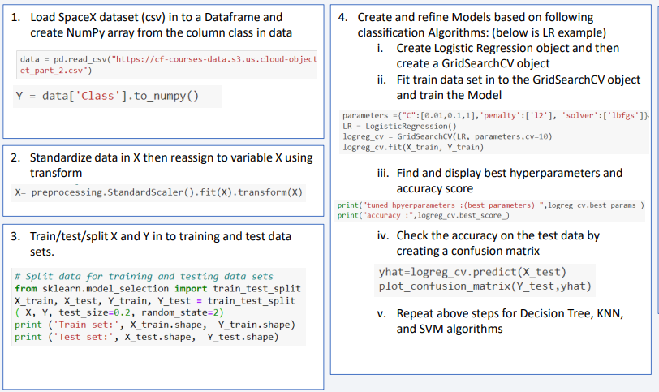
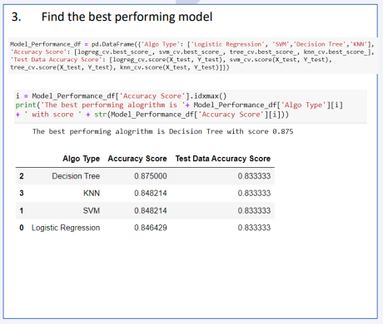
Predictive Analysis (Classification)

Slide 16
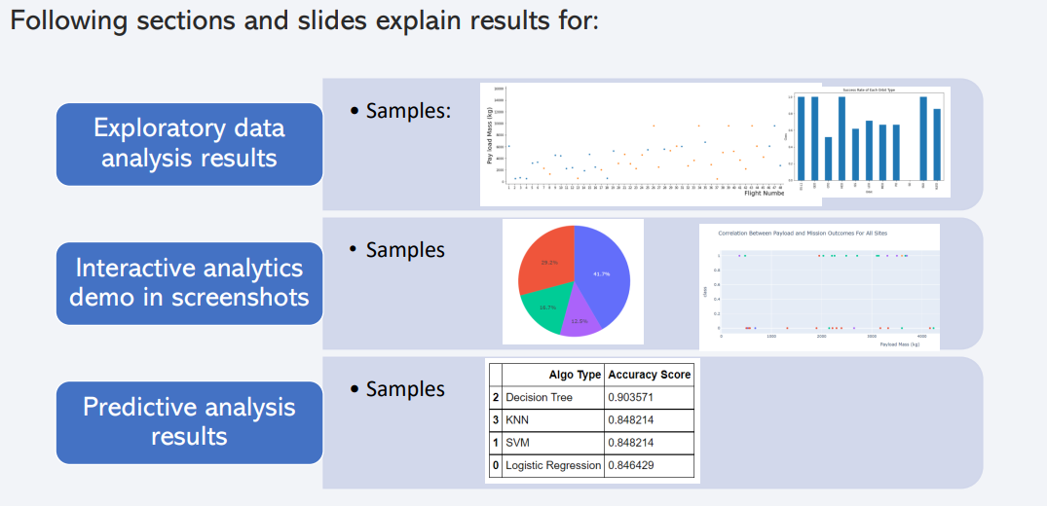
Results

Slide 17

Section 2

Slide 18
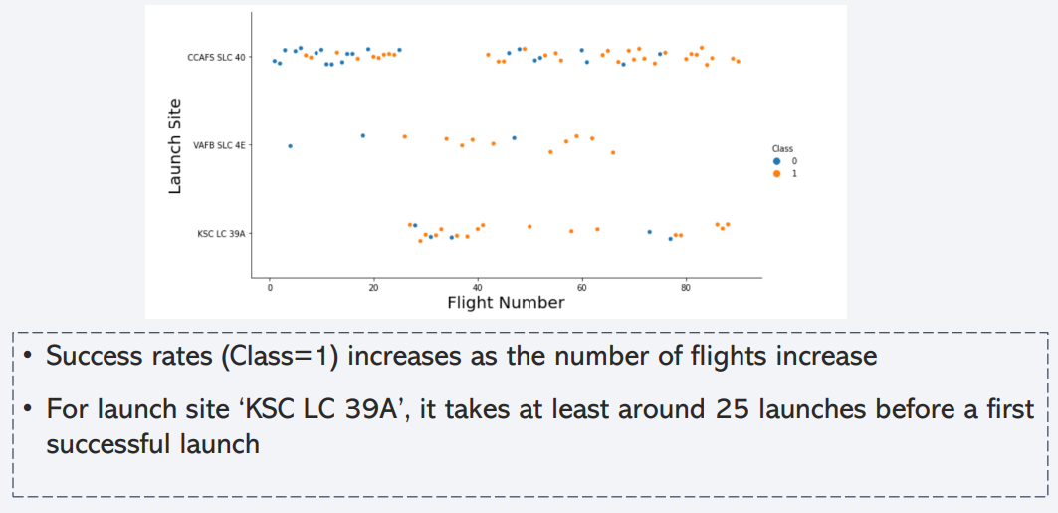
Flight Number vs. Launch Site

Slide 19
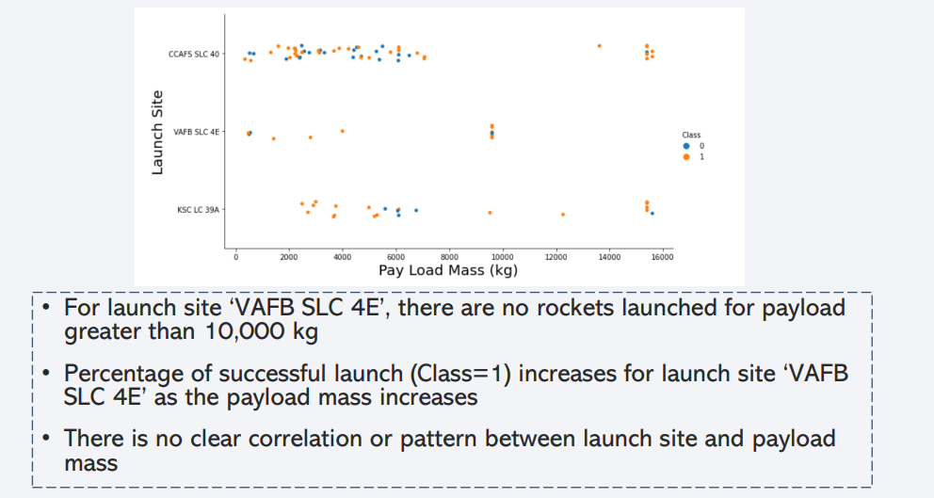
Payload vs. Launch Site

Slide 20
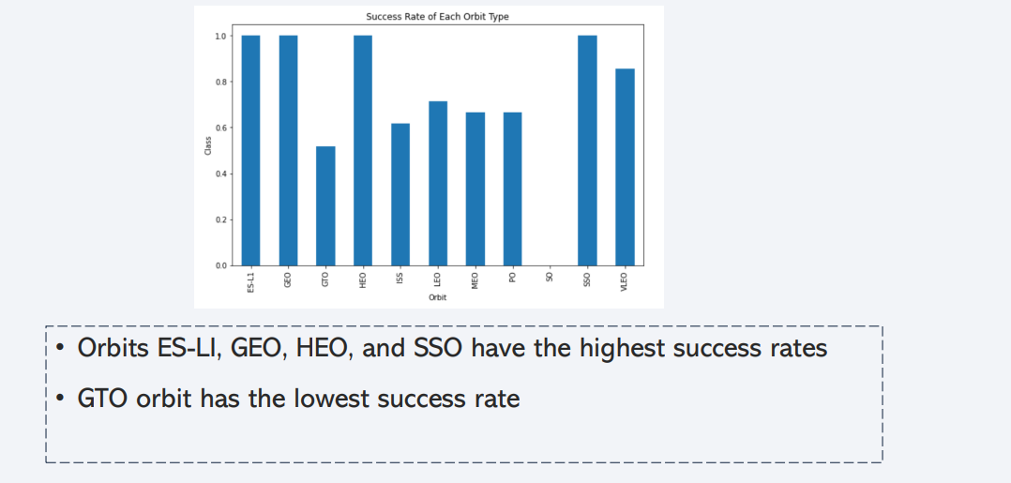
Success Rate vs. Orbit Type

Slide 21
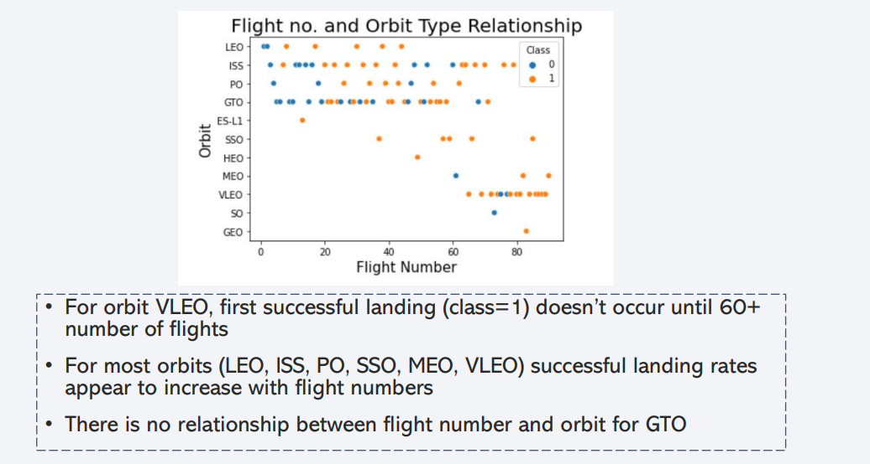
Flight Number vs. Orbit Type

Slide 22
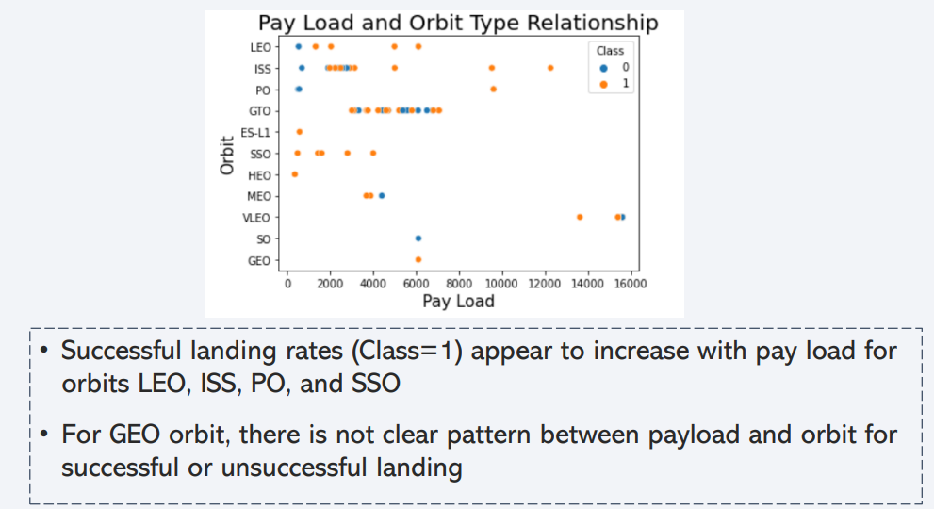
Payload vs. Orbit Type

Slide 23
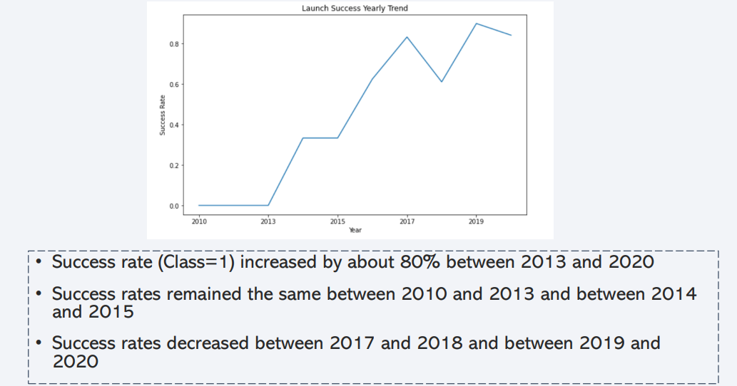
Launch Success Yearly Trend

Slide 24
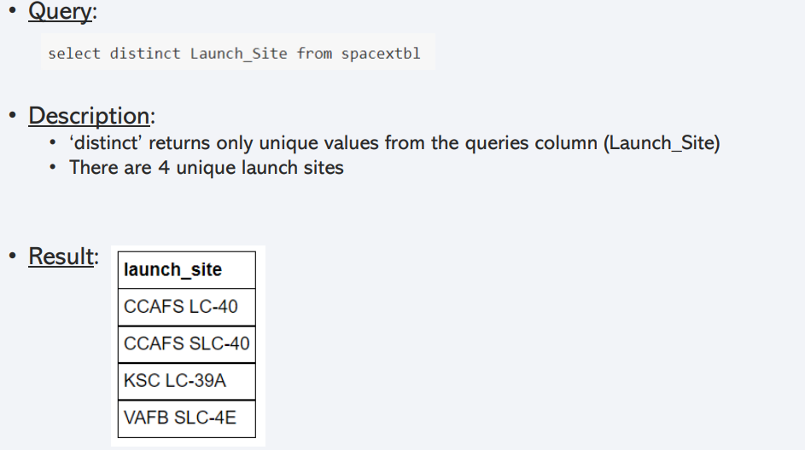
All Launch Site Names

Slide 25
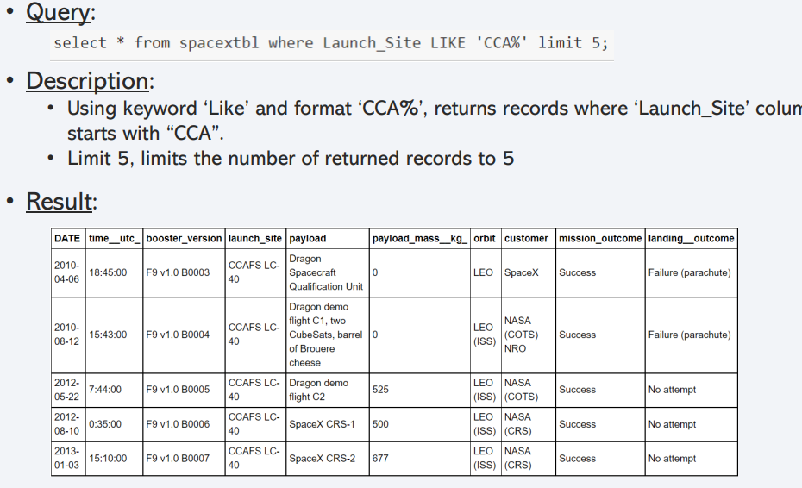
Launch Site Names Begin with 'CCA'

Slide 26
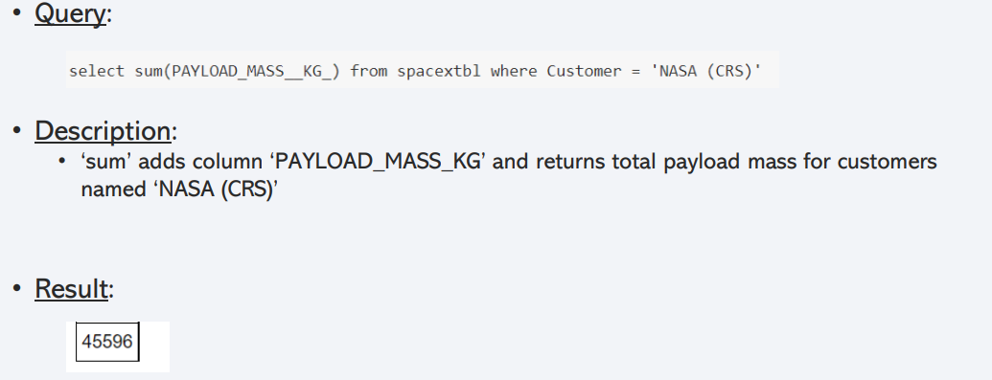
Total Payload Mass

Slide 27
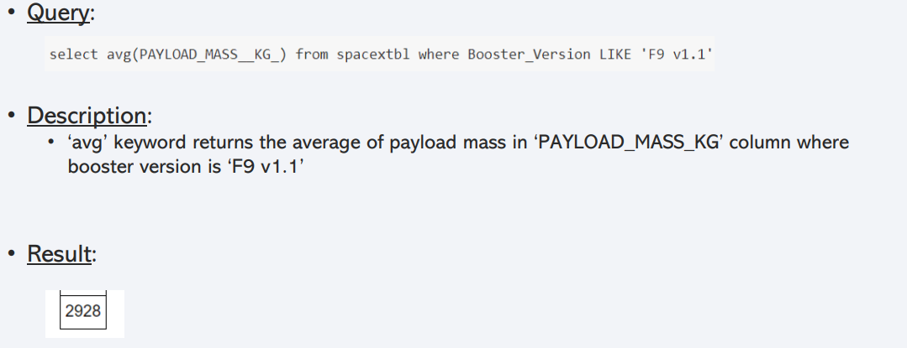
Average Payload Mass by F9 v1.1

Slide 28
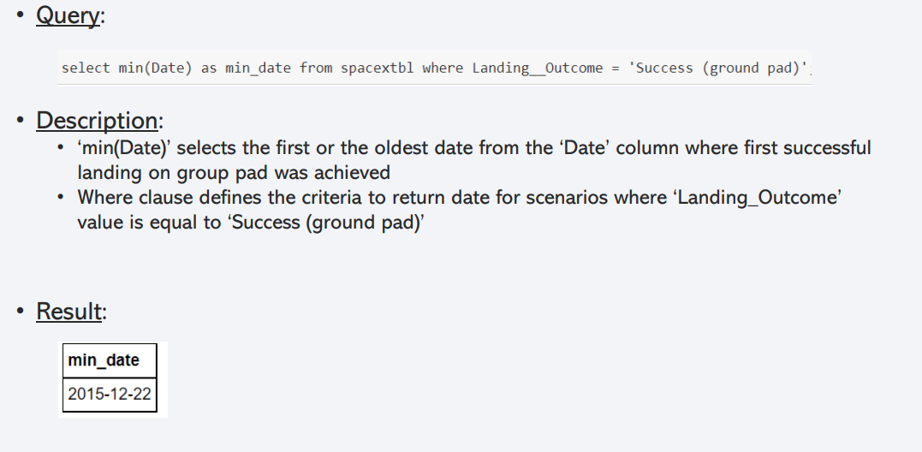
First Successful Ground Landing Date

Slide 29
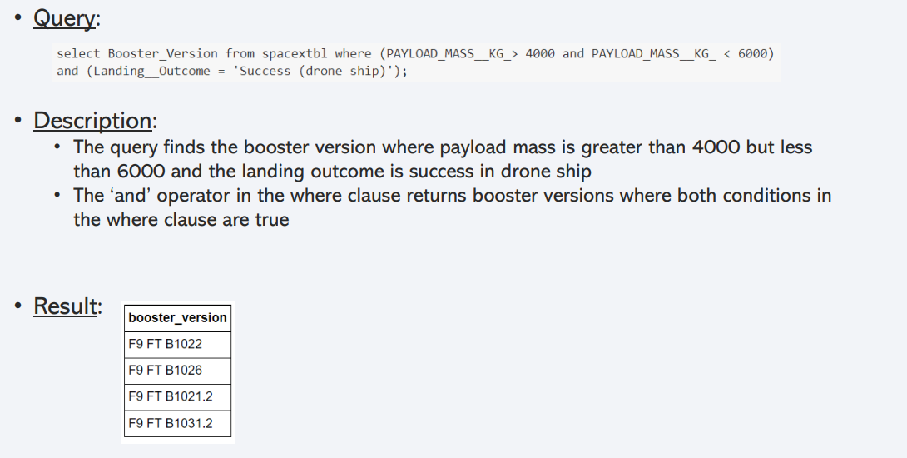
Successful Drone Ship Landing with Payload between 4000 and 6000

Slide 30
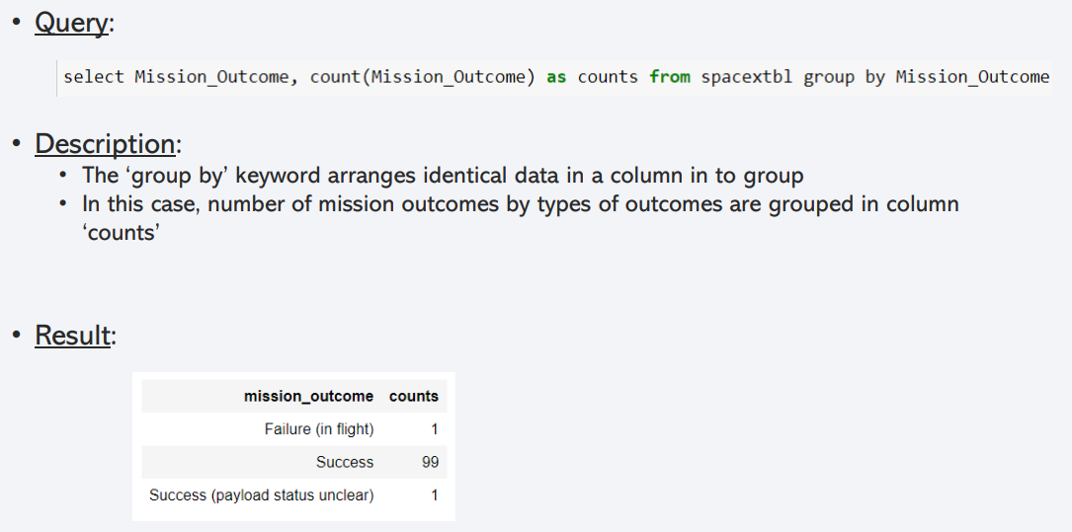
Total Number of Successful and Failure Mission Outcomes

Slide 31
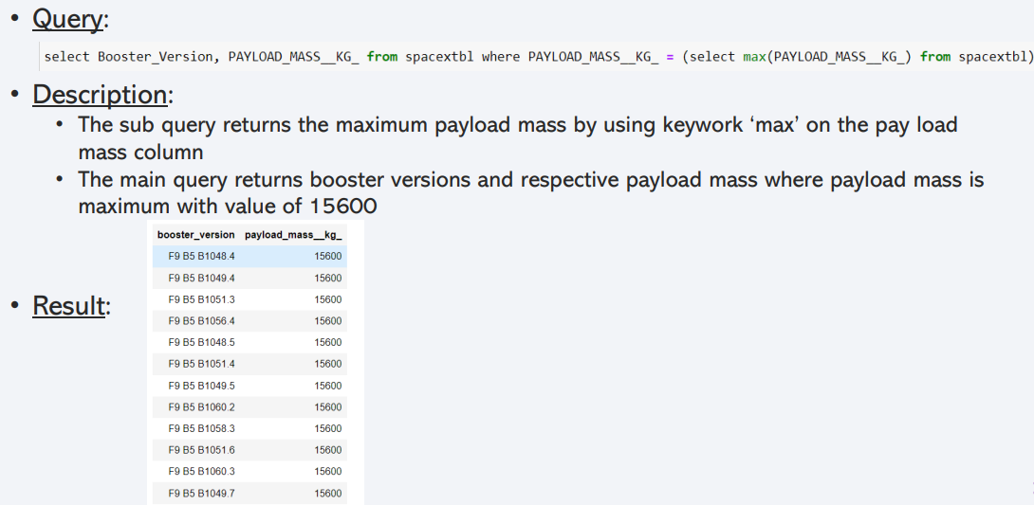
Boosters Carried Maximum Payload

Slide 32
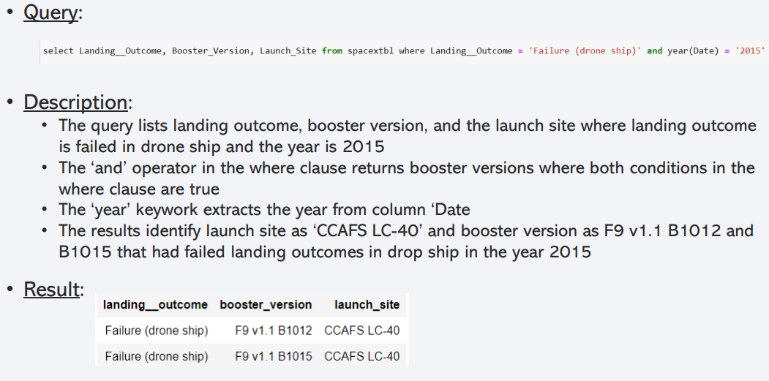
2015 Launch Records

Slide 33
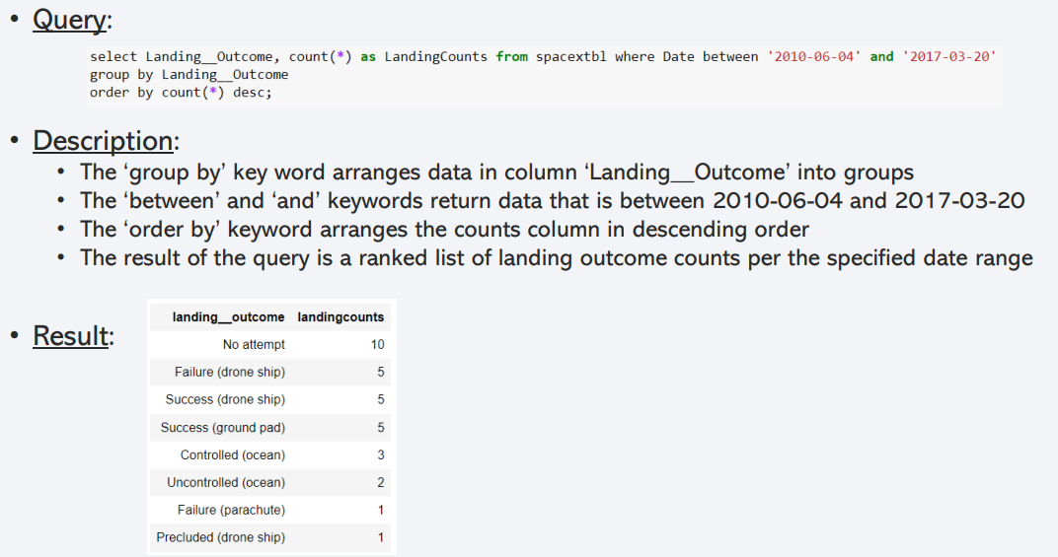
Rank Landing Outcomes Between 2010-06-04 and 2017-03-20

Slide 34

Section 3

Slide 35
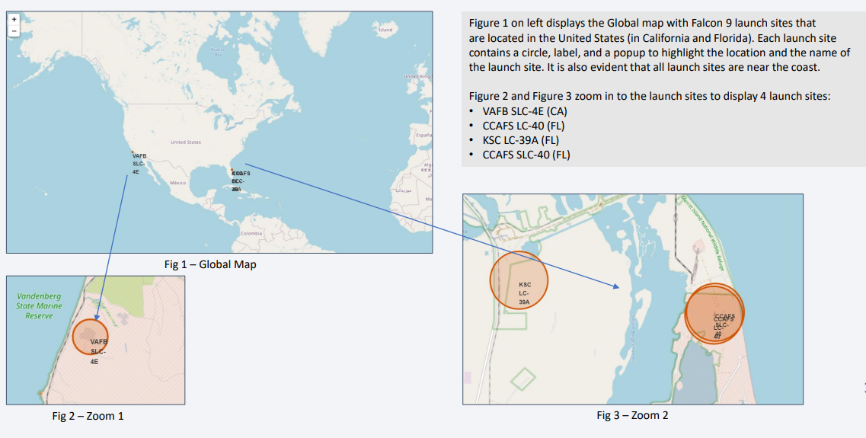
SpaceX Falcon9 - Launch Sites Map

Slide 36
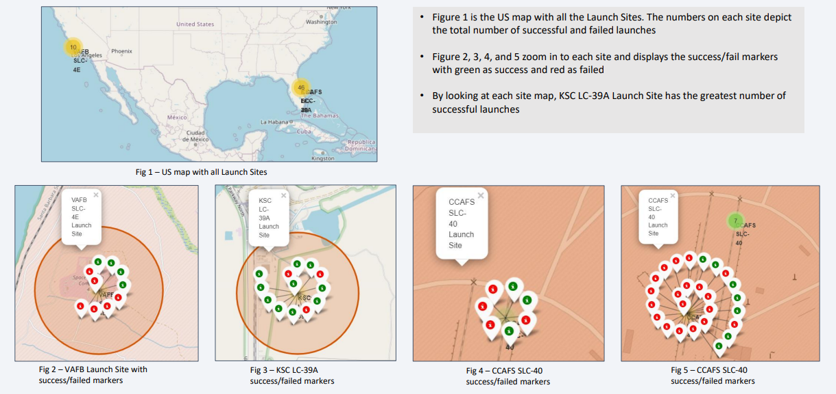
SpaceX Falon9 – Success/Failed Launch Map for all Launch Sites

Slide 37
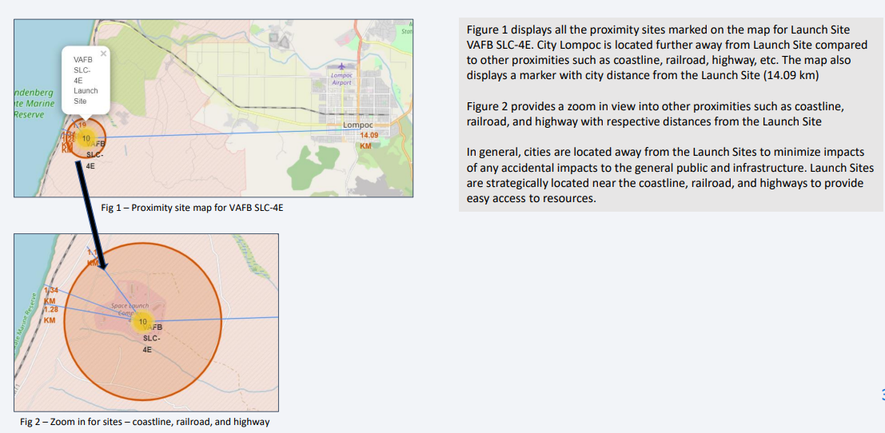
SpaceX Falcon9 – Launch Site to proximity Distance Map

Slide 38

Section 4

Slide 39
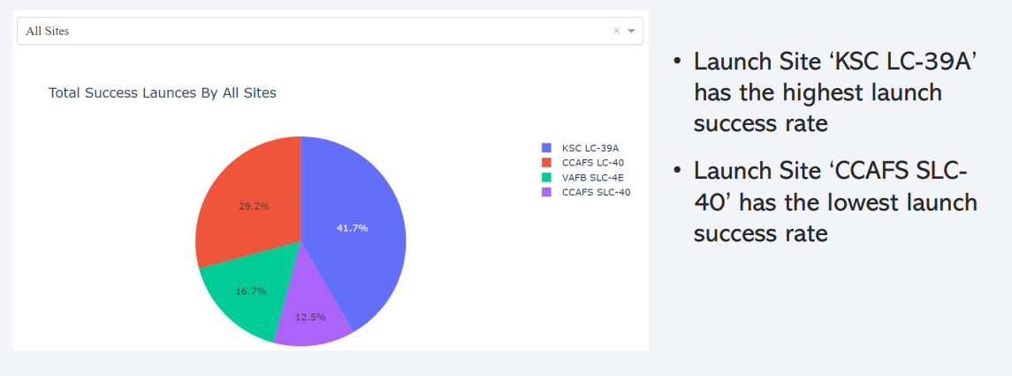
Launch Success Counts For All Sites

Slide 40
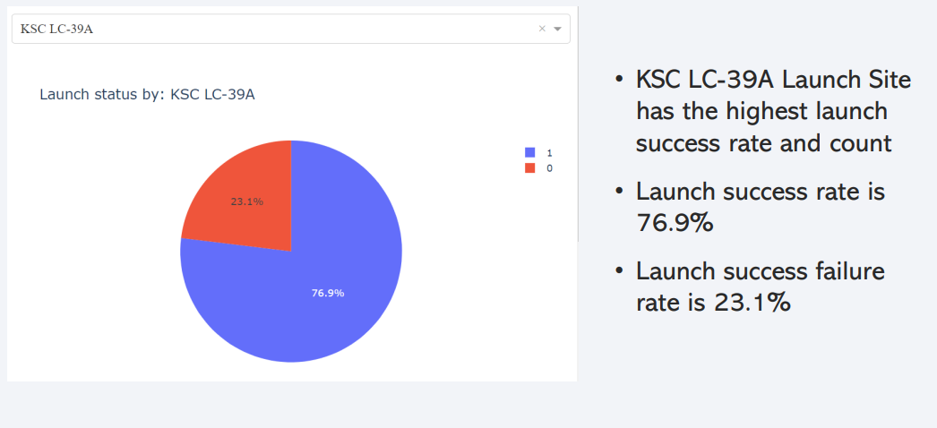
Launch Site with Highest Launch Success Ratio

Slide 41
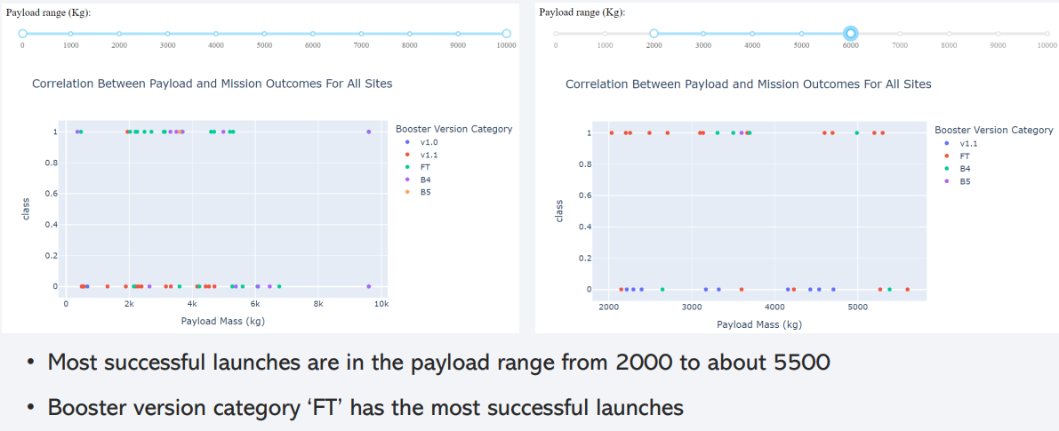
Payload vs. Launch Outcome Scatter Plot for All Sites

Slide 42

Section 5

Slide 43
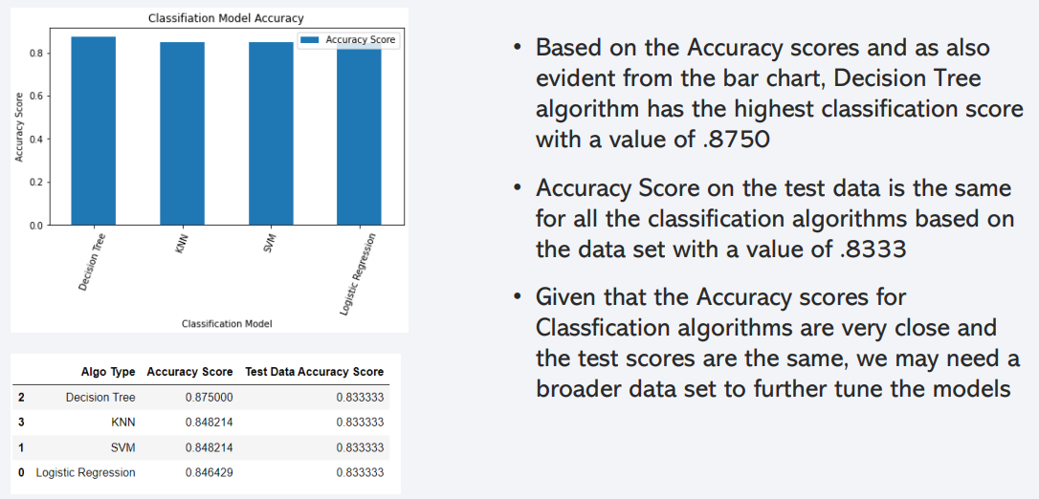
Classification Accuracy

Slide 44
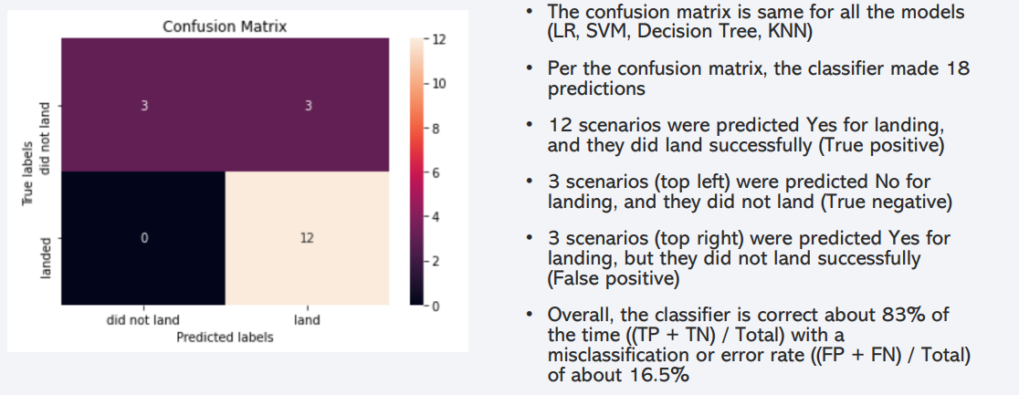
Confusion Matrix

Slide 45
Conclusions
As the numbers of flights increase, the first stage is more likely to land successfully
Success rates appear go up as Payload increases but there is no clear correlation between Payload mass and success rates
Launch success rate increased by about 80% from 2013 to 2020
Launch Site ‘KSC LC-39A’ has the highest launch success rate and Launch Site ‘CCAFS SLC40’ has the lowest launch success rate
Orbits ES-L1, GEO, HEO, and SSO have the highest launch success rates and orbit GTO the lowest
Lunch sites are located strategically away from the cities and closer to coastline, railroads, and highways
The best performing Machine Learning Classification Model is the Decision Tree with an accuracy of about 87.5%. When the models were scored on the test data, the accuracy score was about 83% for all models. More data may be needed to further tune the models and find a potential better fit.

Slide 46
Appendix
Include any relevant assets like Python code snippets, SQL queries, charts, Notebook outputs, or data sets that you may have created during this project

Slide 47


